Slide 1
Encrypted Search
Enabling standard information retrieval techniques for several new secure index types while preserving confidentiality
Alex Towell (atowell@siue.edu)

Slide 2
Motivation for Encrypted Search
Notes:
Reliable
Scalable
Cost-effective
Accessible
Organizations trust cloud storage providers (CSP) with storage logistics but not with confidentiality.

Slide 3
Naïve solution to confidentiality
Use standard encryption
Client encrypts documents before uploading to untrusted system
To search encrypted documents:
Download them to a trusted machine
Decrypt them
Search through them
Primary problem: Time consuming

Slide 4
Encrypted Search: efficient solution to confidentiality
What we want: Give untrusted system (CSP) ability to search confidential documents on behalf of clients without disclosing any information, except which documents are relevant to the search
CSP performs oblivious searching on behalf of authorized clients
CSP doesn’t know what the query is, nor what the confidential documents contain
CSP cannot meaningfully search on its own
Can only search on behalf of authorized clients
Something that meets these requirements is called…
Encrypted Search

Slide 5
Overview
New secure indexes based on Perfect Hash Filter (PHF)
Encrypted Search facilitated by secure indexes.
Standard information retrieval w/confidentiality
BM25
MinDist*
Mitigate information leaks from:
Queries
Contents of secure indexes

Slide 6
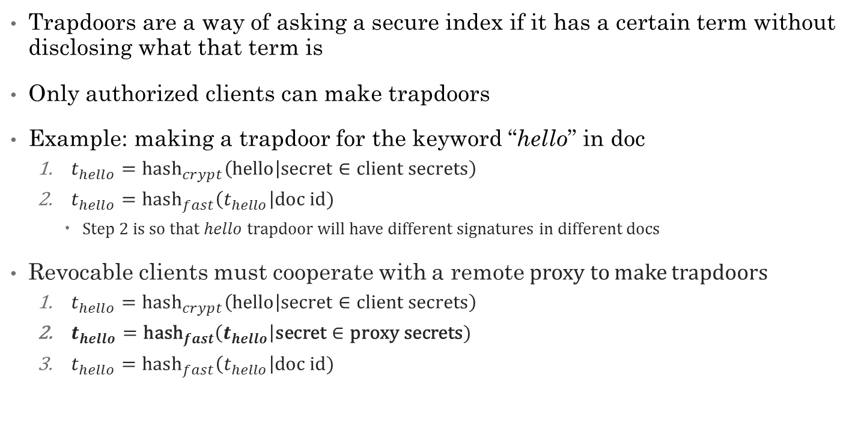
Trapdoors
Trapdoors are a way of asking a secure index if it has a certain term without disclosing what that term is
Only authorized clients can make trapdoors
Example: making a trapdoor for the keyword “hello” in doc
$t_{hello}={\text{hash}}_{crypt}\left(hello | \text{secret}∈\text{client} \text{secrets}\right)$
${t_{hello}=\text{hash}}_{fast}\left(t_{hello}\right|\text{doc} \text{id})$
Step 2 is so that $hello$ trapdoor will have different signatures in different docs
Revocable clients must cooperate with a remote proxy to make trapdoors
$t_{hello}={\text{hash}}_{crypt}\left(hello | \text{secret}∈\text{client} \text{secrets}\right)$
${t_{hello}=\text{hash}}_{fast}\left(t_{hello}\right|\text{secret}∈\text{proxy} \text{secrets})$
${t_{hello}=\text{hash}}_{fast}\left(t_{hello}\right|\text{doc} \text{id})$
Notes:
${\text{hash}}_{crypt}$ is cryptographic hash function, e.g., SHA256
${hash}_{fast}$ is fast hash function that distributes keys uniformly, e.g., JenkinsHash
Revocability: introduce intermediate step where we mix in a remote proxy’s secret, which is unknown to the client, so that the client must cooperate with the proxy to make trapdoors.

Slide 7
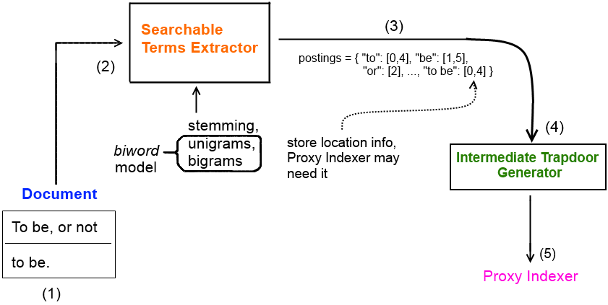
Document processor: trapdoor extraction
Document Processor extracts intermediate trapdoor signatures from doc
Uses a biword model for exact phrase search
make trapdoors for unique unigrams and bigrams
decompose exact phrases in queries to a chain of bigrams
more on this later

Slide 8
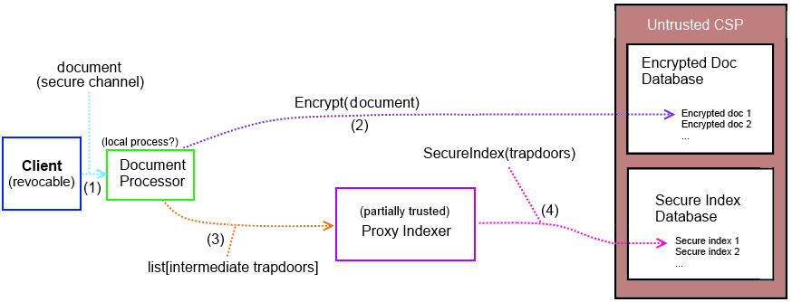
Overview: secure index construction

Slide 9
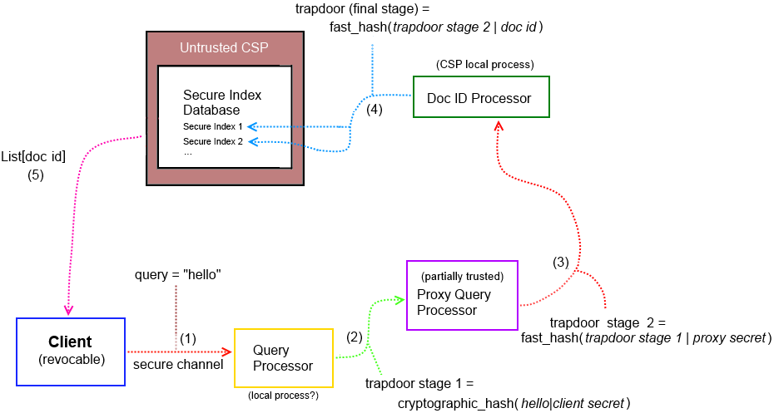
Overview: searching secure indexes

Slide 10
Revocable client access
Query Processor and Proxy Query Processor stages support client revocability
client secrets must be co-mingled with proxy secrets to make trapdoors
To revoke client, inform proxy not to co-mingle its secret with the client’s
Client may not even query a local copy of a secure index
…assumes client and proxy do not collude
To mitigate collusion risk, a chain (or directed acyclic graph) of proxies may be used
Every link in the chain must collude with client
…costly

Slide 11
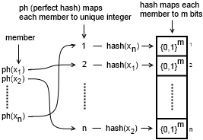

Perfect Hash Filter (PHF)
PHF $∈$ probabilistic set
Composition of perfect hash (ph), normal hash, and a bit vector for storing hash values from the normal hash
False positive rate $ε=\frac{1}{2^{m}}$
Assuming good hash function
Space complexity of size $n$ set
$2.06n+{nlog}_{2}{\frac{1}{ε}=}n(2.06+m)$
Assuming perfect minimal hash
Use PHF as basis for several secure index types
Notes:
Maps each member of set to a unique integer – no collisions among members.
How can this be done? A naïve way of doing it is just to try different hash functions on the members until they result in no collisions.

Slide 12
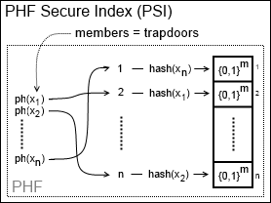

PHF Secure Index (PSI)
Based on PHF, just with trapdoors (for doc) as its $n$ members
Space complexity = $n\left(2.06+m\right)$
No frequency/location info
Boolean search only
Exact phrase search using biword model
doc = “a b b d” query = “a b b” $→$ has “a b” and “b a”
biword false positive occurs for query = “a b d”
Larger phrase $↔$ lower biword false positive rate

Slide 13
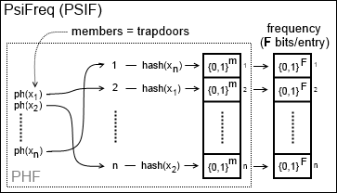

PsiFreq (PSIF)
Composition of PHF + bit vector, for storing frequencies
No location info stored
Compactly stores freq info in $F$ bits per trapdoor
Approximate freq for positive phrases $>2$ words
Phrase $p$ frequency:
extract bigrams from $p$ and bigram with min freq is upper-bound

Slide 14
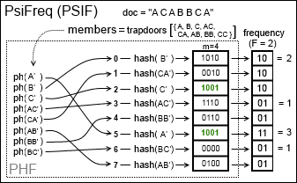

PSIF example
doc = “A C A B B C A”
$F=\log_{2}{(max{freq+1)}}=\log_{2}{(3+1)}=2$
$m=4→\frac{1}{16}$ false positive rate
$freq\left(A C A\right)=min\left\{\begin{aligned}\text{freq}\left(A C\right)=2, \\ \text{freq}\left(C A\right)=1\end{aligned}\right\}=1$
$freq\left(A B C\right)=min\left\{\begin{aligned}\text{freq}\left(A B\right),=1 \\ \text{freq}\left(B C\right)=1\end{aligned}\right\}=1$
“A B C” not in doc
biword false positive
Notes:
Space: $\left\lceil \text{8}\left(2.06+4+2\right)\right\rceil =65 bits$
must pad to nearest byte: 72 bits

Slide 15
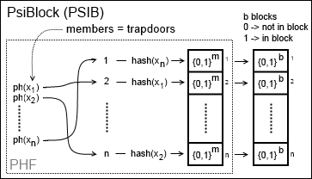

PsiBlock (PSIB)
PHF + bit vector for storing approximate locations
implicitly stores approximate frequencies
Segment doc into $b$ blocks
Map each trapdoor to $b$ bits, each bit represents an approximate position
If trapdoor is in a block, make corresponding bit a 1
Inefficient for large $b$
Sparse bit vector

Slide 16
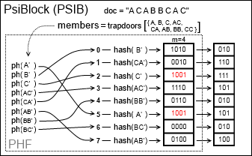
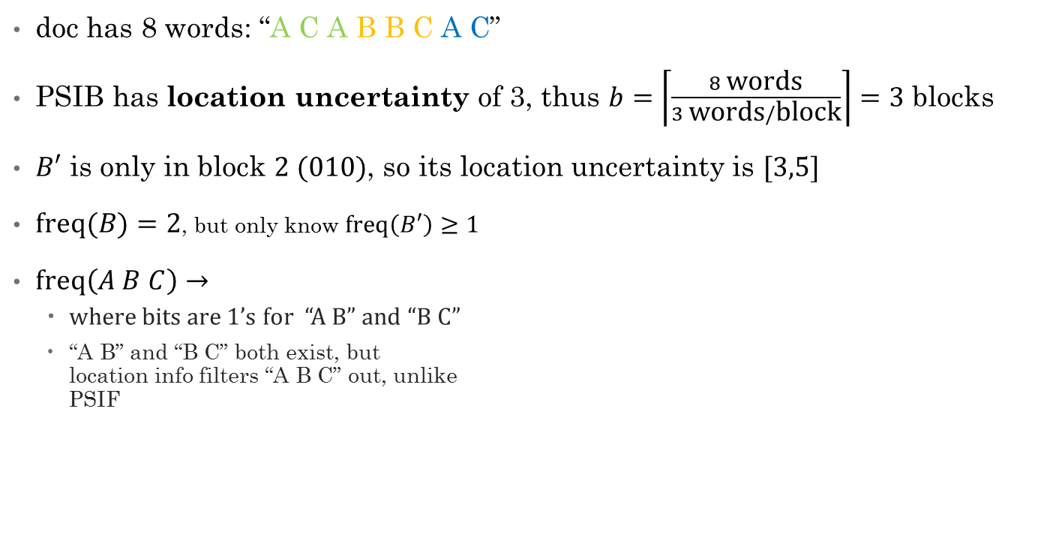
PSIB example
doc has 8 words: “A C A B B C A C”
PSIB has location uncertainty of 3, thus $b=\left\lceil \frac{8 \text{words}}{3 \text{words}/\text{block}}\right\rceil =3$ blocks
$B′$ is only in block $2 (010)$, so its location uncertainty is $[3,5]$
$\text{freq}(B)=2$, but only know $\text{freq}\left(B′\right)≥1$
$\text{freq}\left(A B C\right)→$
where bits are 1’s for “A B” and “B C”
“A B” and “B C” both exist, but location info filters “A B C” out, unlike PSIF
Notes:
Fast bit-wise operations possible (AND)

Slide 17
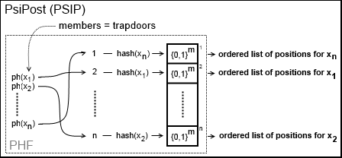
PsiPost (PSIP)
Composition of PHF + postings list
locations – store a scrambled list of positions for each trapdoor
each position is randomly offset up to a max radius of uncertainty
locations of phrase are where all its bigrams are within radius of uncertainty
frequency: size of a trapdoor’s list of positions

Slide 18

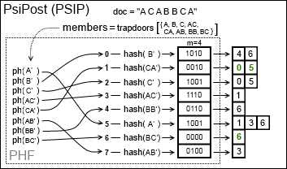

PSIP example
doc =
locations(B C A )?
locations(B C) = { 6 }, locations(C A) = { 0, 5 }
If a location for “B C” and a location for “C A” is $≤2×\text{radius}=4$, count as hit
B C @ 6 and C A @ 0? No.
B C @ 6 and C A @ 5? Yes.
$6−5≤4$
Take mean position to be position of “B C A” $→5.5$

Slide 19
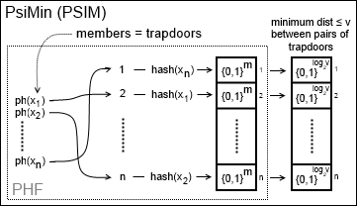

PsiMin (PSIM)
Composition of a PHF + a bit vector to represent the minimum pairwise distance between trapdoors
minimum distance must be less than threshold distance $v$, otherwise ignored
trapdoors are pairs of keywords $→$ “hello|world”
Compliment to other secure indexes
give them extra sensitivity to nearby trapdoors

Slide 20
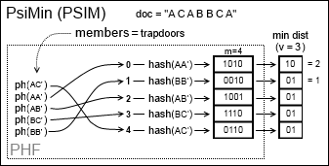

PSIM example
MinPairwiseDistance(A,C) = $1$
MinPairwiseDistance(C,C) = 4 $≥v$, so don’t include

Slide 21
Evaluating Encrypted Search information retrieval (IR) performance
How effective is our Encrypted Search scheme?
Many ways to measure effectiveness
Time-complexity – latency
Space-complexity – how many secure indexes can fit into system memory?
Search retrieval accuracy

Slide 22
Time complexity performance
How long does it take IR system to respond to query?
Most users aren’t willing to wait much longer than a second
PSI-derived indexes: O(1) as expected
BSIB indexes: O(n) (proportional to # blocks)
For large collections, BSIB too slow?
~80k docs > 1 sec (avg ~60 pages/doc)
Notes:
One of the primary reasons for PSI-based secure indexes.

Slide 23

Space complexity performance
How much memory do the secure indexes require? PSIB: $n\left\lceil 2.06+\log_{2}{\frac{1}{ε}}+b\right\rceil$
PSIF: $n\left\lceil 2.06+\log_{2}{\frac{F}{ε}}\right\rceil$
PSIP: $n\left\lceil 2.06+\log_{2}{\frac{1}{ε}}\right\rceil +O\left(n\overline{f}\right)$
$\overline{f}$ is average frequency
PSIM: $O\left(vw\left\lceil 2.06+\log_{2}{\frac{v}{ε}}\right\rceil \right)$
$w$ is # word positions
BSIB: $\left\lceil (1.44n+r)\log_{2}{\frac{1}{ε}}\right\rceil$
Notes:
$\text{Notes}\text{:} s=2.07 if using minimal perfect hash$, $ε=\text{false} \text{positive} \text{rate}\text{, }n=\text{number} \text{of} \text{unique} \text{unigrams} \text{and} \text{bigrams} \text{in} \text{doc}$
PSIB: $n\left\lceil s+\log_{2}{\frac{1}{ε}}+b\right\rceil , b=\# of blocks$
PSIF: $n\left\lceil s+\log_{2}{\frac{F}{ε}}\right\rceil ,F=$maximum frequency of any word in doc
PSIP: $n\left\lceil s+\log_{2}{\frac{1}{ε}}\right\rceil +w\sum_{x∈\left\{\text{unigrams}\right\}∪\{\text{bigrams}\}}{\text{freq}(x)}$, $w$ is # bits needed to represent any position (much better can be done as outlined in paper)
PSIM: $vN\left\lceil s+\log_{2}{\frac{v}{ε}}\right\rceil$, where $v$ is threshold distance, $N$ is # words in doc, and assuming $v$ is small
BSIB: $\left\lceil (1.44n+r)\log_{2}{\frac{1}{ε}}\right\rceil$, where $r$ is # bits needed to represent a seed value for seeding the hash function

Slide 24
Measuring search retrieval accuracy
Encrypted Search retrieves documents in response to queries
How good is this response?
Operationally defined relevant (“true”) results for a given query and document collection as the documents retrieved from by canonical indexes
Canonical indexes: non-secures index which store exact information
To measure Encrypted Search retrieval accuracy, we compare its retrieved results with the relevant (canonical) results.
Boolean search: precision and recall
Degrees of relevancy search: mean average precision (MAP)
Basically, measure how close Encrypted Search is to canonical search

Slide 25
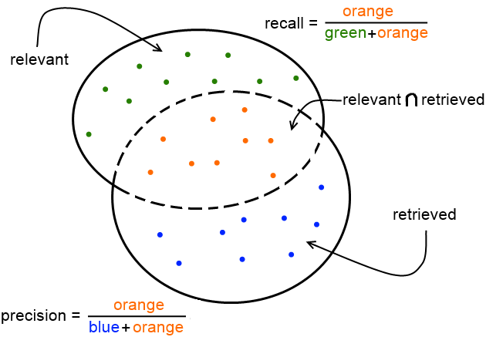

Boolean search
Boolean search
Either a doc is relevant or irrelevant
$\text{precision}=\frac{\left\{\text{relevant}\right\}∩\{\text{retrieved}\}}{\{\text{retrieved}\}}$
$\text{recall}=\frac{\left\{\text{relevant}\right\}∩\{\text{retrieved}\}}{\{\text{relevant}\}}$
Trivial to get 100% recall by retrieving everything.
Generally a trade-off between recall and precision

Slide 26
Boolean search
0.001 false positive rate
More words in phrase, more precision
All converge to 100% for large phrases
More terms, less recall
PSIB/BSIB especially, but can be improved

Slide 27
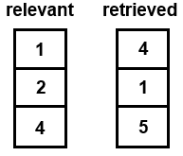
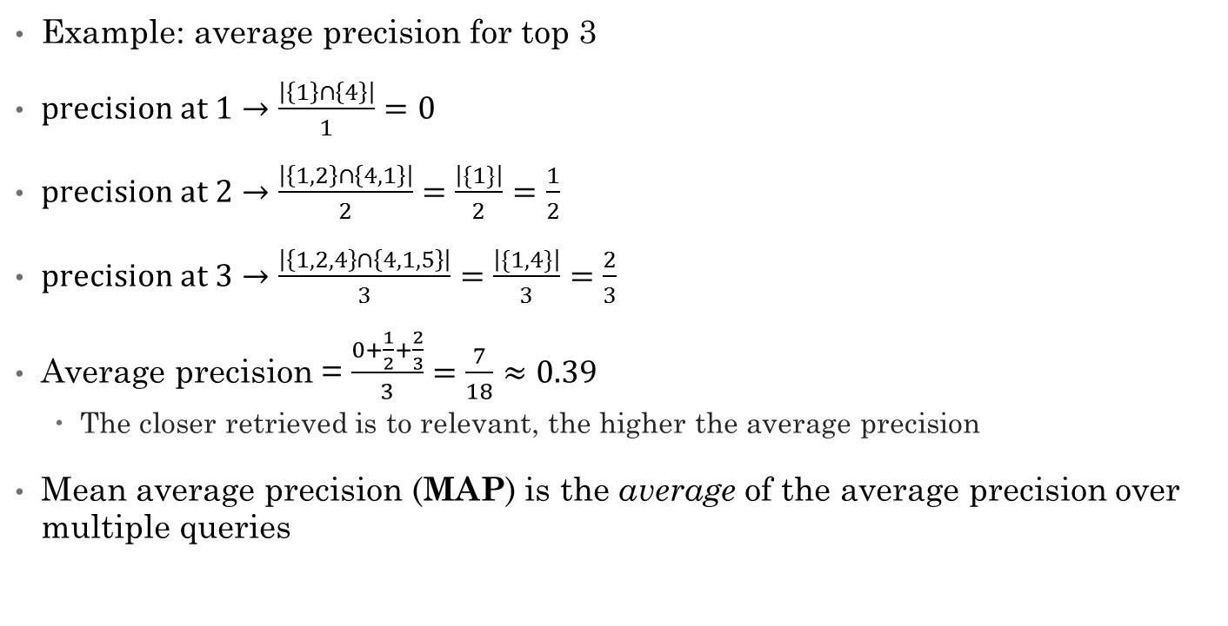
Measuring accuracy of rank-ordered searches
Example: average precision for top 3
$precision at 1→\frac{\left|\left\{1\right\}∩\left\{4\right\}\right|}{1}=0$
$precision at 2→\frac{\left|\left\{1,2\right\}∩\left\{4,1\right\}\right|}{2}=\frac{\left|\{1\}\right|}{2}=\frac{1}{2}$
$precision at 3→\frac{\left|\left\{1,2,4\right\}∩\left\{4,1,5\right\}\right|}{3}=\frac{\left|\{1,4\}\right|}{3}=\frac{2}{3}$
Average precision = $\frac{0+\frac{1}{2}+\frac{2}{3}}{3}=\frac{7}{18}≈0.39$
The closer retrieved is to relevant, the higher the average precision
Mean average precision (MAP) is the average of the average precision over multiple queries

Slide 28

BM25 rank-ordered search
Term weighting heuristic
Rare terms (in collection) important
Frequent terms (in doc) important
Out of 1000 documents, retrieve 10 most relevant. What is MAP?
For PSIB/BSIB, MAP $≥80\%$ if location uncertainty$<250$
BM25 tolerant of approximate frequencies
For, PSIP/PSIF, MAP ~97%
Independent of location uncertainty
All converge to ~97% as location uncertainty converges to 5 words

Slide 29

MinDist rank-ordered search
Term proximity heuristic
Terms in close proximity are relevant to each other
Relevancy quickly diminishes with distance
Out of 1000 documents, retrieve 10 most relevant
MinDist* very sensitive to location uncertainty
For MAP accuracy $>70\%$ PSIP location uncertainty $≤2$0 and PSIB/BSIB $≤10$
This is dangerous, especially for PSIB/BSIB
PSIM to the rescue?

Slide 30
Protecting confidentiality
Already measured Encrypted Search’s traditional information retrieval performance
What about its performance at providing confidentiality?
Confidentiality amounts to leaking information
Three types of information to protect:
Contents of queries -- query privacy
Contents of documents -- document confidentiality
Other activities related to search -- access patterns/implicit information

Slide 31
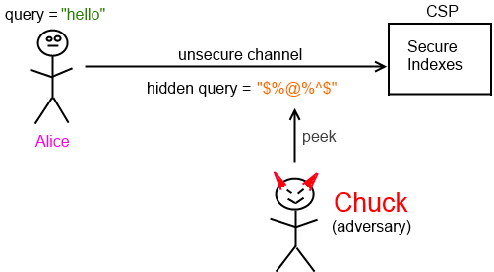
Query privacy
Query privacy not seriously considered when adversary has access to query history.
Start with a plaintext query
query = “hello”
Convert into a hidden query (trapdoor)
hidden query = hash(hello|secret)
Is this good enough?
Query privacy is one of the weakest links in the chain
Hidden queries (trapdoors) are a substitution cipher

Slide 32
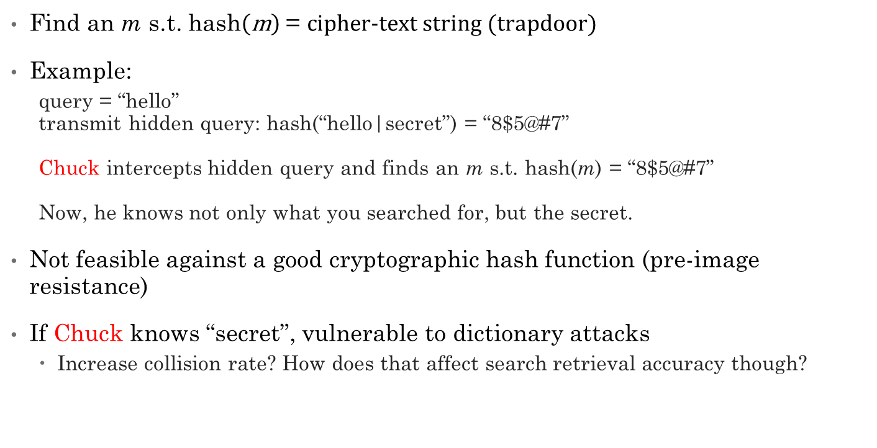
Cryptographic hash attacks
Find an m s.t. $\text{hash}\left(\text{m}\right) \text{=} \text{cipher}\text{-}\text{text} \text{string}\text{ (}\text{trapdoor}\text{)}$
Example:
query = “hello” transmit hidden query: hash(“hello|secret”) = “8$5@#7” Chuck intercepts hidden query and finds an m s.t. hash(m) = “8$5@#7” Now, he knows not only what you searched for, but the secret.
Not feasible against a good cryptographic hash function (pre-image resistance)
If Chuck knows “secret”, vulnerable to dictionary attacks
Increase collision rate? How does that affect search retrieval accuracy though?

Slide 33

Maximum likelihood estimate (MLE) attacks
Suppose Chuck doesn’t know “secret”
Estimate plaintext word distribution f
Simple bag-of-words model (f ~ Zipf)
More sophisticated models possible
Find a function $\tilde{g}$ that maps cipher-text to plaintext so that probability of seeing those ciphers is maximized
$\tilde{g}=\underset{g}{argmax}{\prod{f(g\left(cipher\right))}}$
Chuck is 100% accurate with sufficient data
Can spy on users
Can perform Encrypted Searches

Slide 34
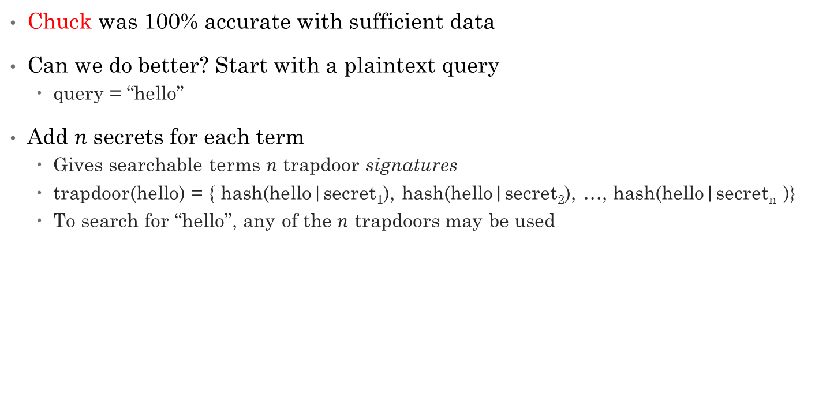
Mitigating MLE attacks with multiple secrets
Chuck was 100% accurate with sufficient data
Can we do better? Start with a plaintext query
query = “hello”
Add $n$ secrets for each term
Gives searchable terms $n$ trapdoor signatures
trapdoor(hello) = { hash(hello|secret₁), hash(hello|secret₂), …, hash(hello|secret_{n} )}
To search for “hello”, any of the $n$ trapdoors may be used

Slide 35

Effect of multiple secrets on query privacy
Chuck (the adversary) is still 100% accurate when given 10 million trapdoors to learn $\tilde{g}$
He can still spy on users
He can still perform Encrypted Searches
Can we do better?

Slide 36
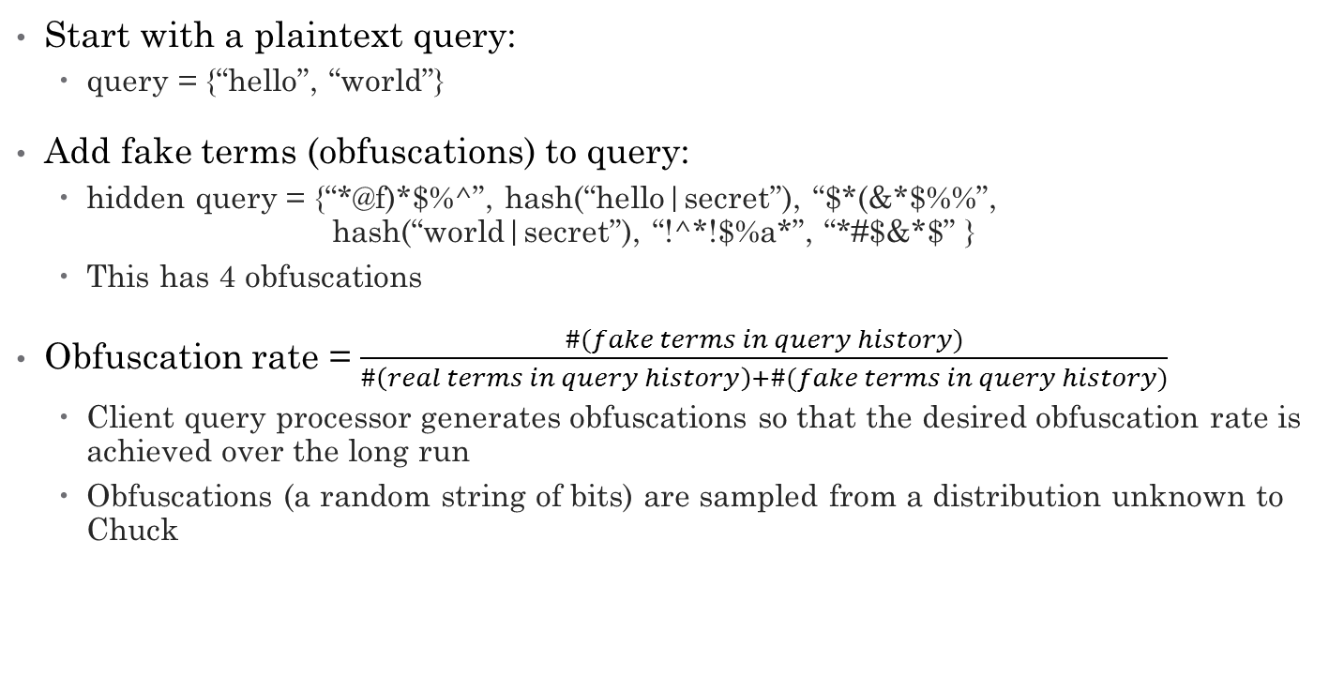
Mitigating MLE attacks with obfuscations
Start with a plaintext query:
query = {“hello”, “world”}
Add fake terms (obfuscations) to query:
hidden query = {“*@f)*$%^”, hash(“hello|secret”), “$*(&*$%%”, hash(“world|secret”), “!^*!$%a*”, “*#$&*$” }
This has 4 obfuscations
Obfuscation rate = $\frac{\#(fake terms in query history)}{\#\left(real terms in query history\right)+\#(fake terms in query history)}$
Client query processor generates obfuscations so that the desired obfuscation rate is achieved over the long run
Obfuscations (a random string of bits) are sampled from a distribution unknown to Chuck

Slide 37
Effect of obfuscations on query privacy
With obfuscations, Chuck is not very successful Why?
An MLE may favor mapping an obfuscation to a real term
Especially since Chuck doesn’t know distribution of obfuscations.
Curse of dimensionality

Slide 38

Obfuscation rate vs search accuracy
How does obfuscation rate affect search retrieval accuracy?
BM25 MAP affected very little if obfuscation rate $≤$ 0.5
Higher obfuscation rate not necessarily better
There’s a sweet spot.
Same story for MinDist*
However, Boolean (AND) search incompatible

Slide 39
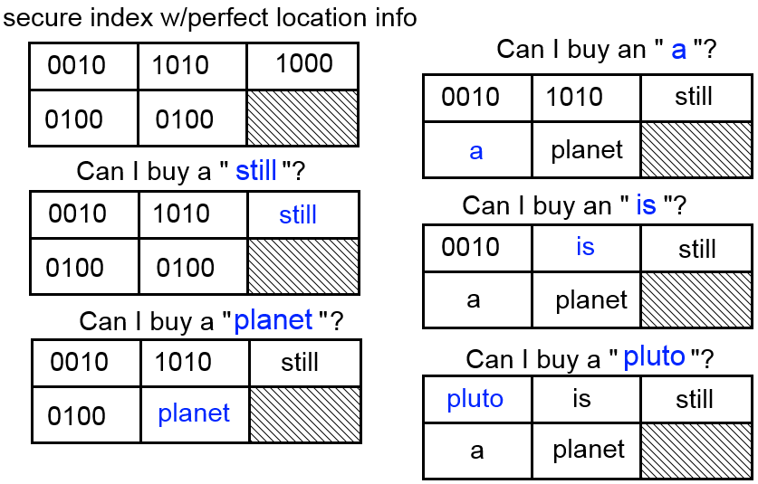
Document confidentiality
Recall: To make a confidential doc searchable, make a secure index for it.
If secure index contains exact location info, confidentiality easily broken.
Wheel of Fortune
As words are put into place, try new words intelligently
Trigram language model P[planet|still a]

Slide 40
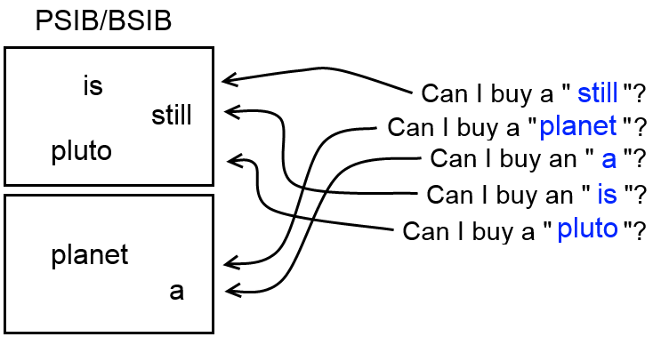
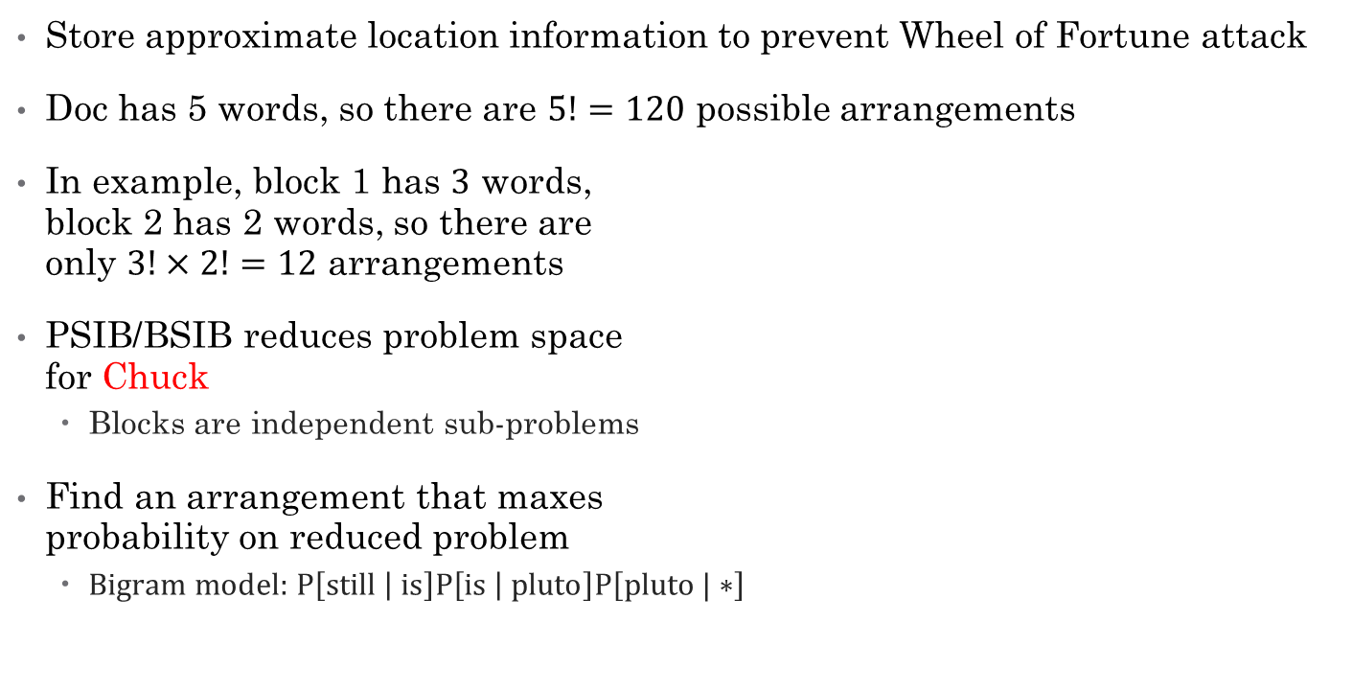
PSIB/BSIB approximate location information
Store approximate location information to prevent Wheel of Fortune attack
Doc has 5 words, so there are $5!=120$ possible arrangements
In example, block 1 has $3$ words, block 2 has 2 words, so there are only $3!×2!=12$ arrangements
PSIB/BSIB reduces problem space for Chuck
Blocks are independent sub-problems
Find an arrangement that maxes probability on reduced problem
$\text{Bigram} \text{model}\text{: }\text{P}\left[\text{still} | \text{is}\right]\text{P}\left[\text{is} | \text{pluto}\right]\text{P}\left[\text{pluto}\text{ | ∗}\right]$

Slide 41

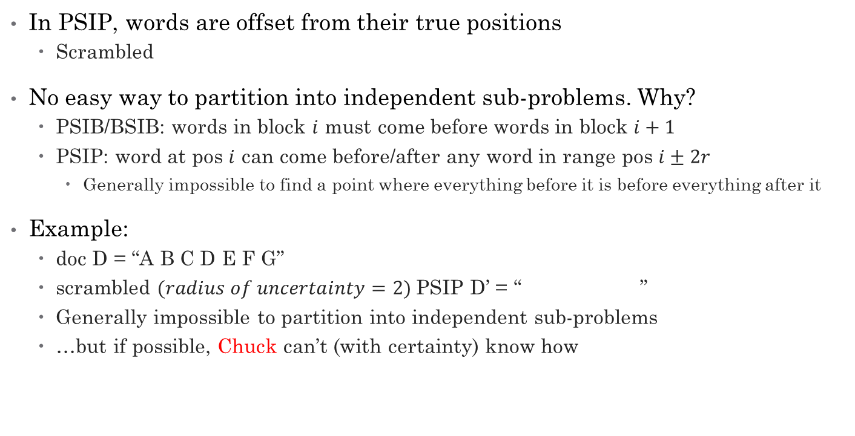
PSIP, Chuck’s (second-most) worst nightmare
In PSIP, words are offset from their true positions
Scrambled
No easy way to partition into independent sub-problems. Why?
PSIB/BSIB: words in block $i$ must come before words in block $i+1$
PSIP: word at pos $i$ can come before/after any word in range pos $i±2r$
Generally impossible to find a point where everything before it is before everything after it
Example:
doc D = “A B C D E F G”
scrambled $(radius of uncertainty=2)$PSIP D’ = “ ”
Generally impossible to partition into independent sub-problems
…but if possible, Chuck can’t (with certainty) know how
Notes:
Impossible to partition into independent sub-problems w/o violating condition that everything in sub-problem $i$ is before (or after) everything in sub-problem $i+1$

Slide 42
PSIM, Chuck’s worst nightmare
PSIM only stores minimum pairwise location information
No absolute location information known!
No way to effectively reduce problem into simpler sub-problems
Has other problems though:
Large index size (depending on min pairwise distance threshold)
Can’t answer absolute location queries
Potentially high false positive rate on exact phrases
Best of both worlds: combine PSIM with another secure index
Sensitive to proximity of nearby words w/out loss of confidentiality
words in a sentence are likely relevant to each other, but words on different pages probably aren’t
Use a small minimum pairwise distance threshold
keeps size down, fallback to other secure index’s more approximate location info for larger distances

Slide 43
Counter-measures against Chuck
Didn’t simulate Chuck reconstructing confidential documents from info in secure indexes
Only simulate him attacking query privacy
Designed and implemented counter-measures against hypothetical Chuck
Evaluated counter measures:
effects of increasing false positive rate on retrieval relevancy
effects of increasing location uncertainty on retrieval relevancy (already covered)
effects of poisoning secure index on retrieval accuracy
E.g., adding junk terms

Slide 44
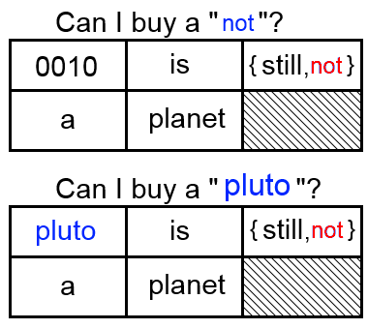
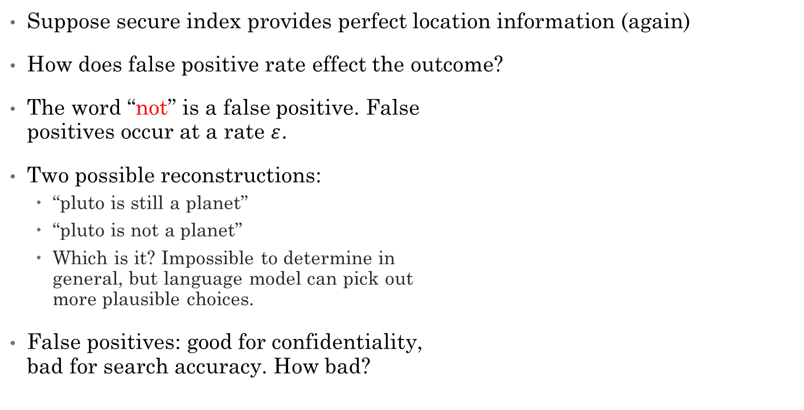
Effect of false positives on doc confidentiality
Suppose secure index provides perfect location information (again)
How does false positive rate effect the outcome?
The word “not” is a false positive. False positives occur at a rate $ε$.
Two possible reconstructions:
“pluto is still a planet”
“pluto is not a planet”
Which is it? Impossible to determine in general, but language model can pick out more plausible choices.
False positives: good for confidentiality, bad for search accuracy. How bad?

Slide 45
False positive rate’s effect on BM25
BM25 is tolerant of extreme false positive rates
Even 25% false positive rate has 70% MAP
BM25 is ranking the docs, so even if a retrieved doc is irrelevant, it may be ranked low
Rank-ordered search tolerant of high false positive rates

Slide 46
False positive rate’s effect on Boolean search
Boolean search less encouraging
At a false positive rate of 0.25, precision falls to 50%
BM25 is far less sensitive to false positive rate than Boolean search
Why?
BM25 degree of relevancy vs Boolean irrelevant/relevant

Slide 47
Junk terms (secure index poisoning) effect on BM25
Junk terms = fake terms
Increasing the junk percentage has a similar effect to confidentiality as increasing the false positive rate
Except: doesn’t degrade retrieval accuracy
See figure, constant

Slide 48
Junk terms effect on space complexity
Junk percentage only has a small effect on compression ratio
20% junk percentage:
~10% for PSIB
~5% for PSIF
~20% for PSIP
Note: Devised a more space- efficient version of PSIP that scales better with junk percentage

Slide 49
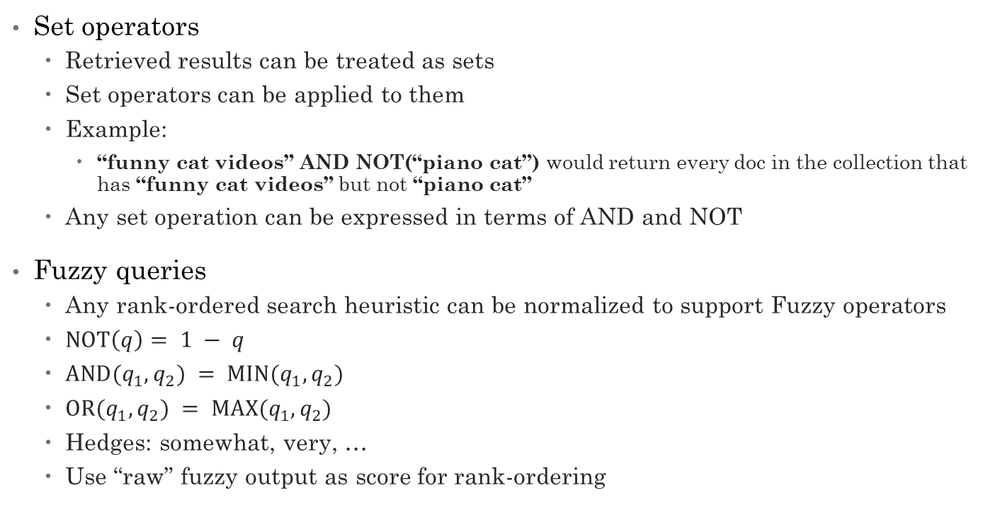
Sets and fuzzy sets
Set operators
Retrieved results can be treated as sets
Set operators can be applied to them
Example:
“funny cat videos” AND NOT(“piano cat”) would return every doc in the collection that has “funny cat videos” but not “piano cat”
Any set operation can be expressed in terms of AND and NOT
Fuzzy queries
Any rank-ordered search heuristic can be normalized to support Fuzzy operators
$\text{NOT}\left(q\right)= 1 − q$
$\text{AND}(q_{1}, q_{2}) = \text{MIN}(q_{1}, q_{2})$
$\text{OR}(q_{1}, q_{2}) = \text{MAX}(q_{1}, q_{2})$
Hedges: somewhat, very, …
Use “raw” fuzzy output as score for rank-ordering

Slide 50
Boolean proximity search
We used MinDist* to rank-order documents
But: an easier way to use the location information in secure indexes is to require that all of the terms in a query be within a minimum proximity of each other
Also: MinDist* and/or BM25 can be used in conjunction with Boolean proximity requirements, e.g., rank-order documents which contain all the terms in the query within one page of each other.

Slide 51
Caching: improving performance
A cache should be used in a real system to avoid duplicating previously calculated results

Slide 52
Future work: access patterns and implicit info leaks
If a hidden query is followed by another action, like checking stock prices, this is an implicit info leak
Ways to mitigate:
Multiple secure indexes/document
purpose: give the same document different retrieval signatures and a different set of trapdoor signatures
Fake secure indexes
purpose: of documents retrieved, obfuscate which are actually of interest to user
Fake queries
purpose: obfuscate user’s actual queries of interest
Future work

Slide 53
Future work: learning optimal parameters
In our research, we manually configured the parameters for the secure indexes and the rank-ordered search heuristics
However, our way of measuring retrieval accuracy can be used to generate an embarrassing amount of data to learn optimal parameters for any given scoring function and secure index
In other words, Big Data
Future work

Slide 54
Future work: miscellaneous
Conduct experiments combining PSIB/PSIP indexes with PSIM
for nearby keywords, use PSIM’s exact min pairwise distance info
otherwise, fallback to PSIB/PSIP’s more approximate location info
Topic search
Semantic search

Slide 55
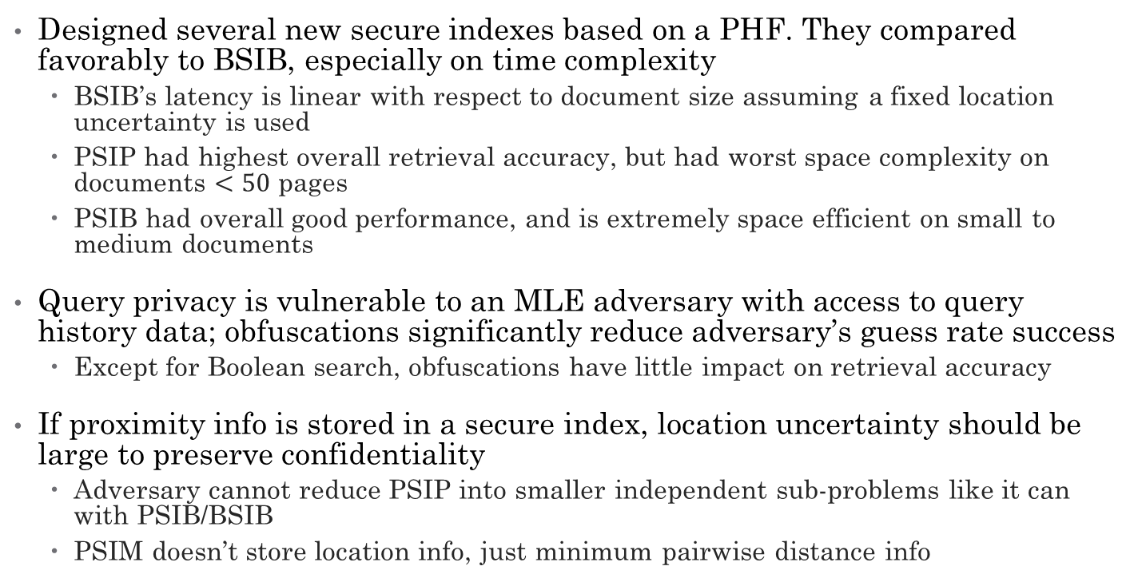
Conclusions (part 1)
Designed several new secure indexes based on a PHF. They compared favorably to BSIB, especially on time complexity
BSIB’s latency is linear with respect to document size assuming a fixed location uncertainty is used
PSIP had highest overall retrieval accuracy, but had worst space complexity on documents $<50$ pages
PSIB had overall good performance, and is extremely space efficient on small to medium documents
Query privacy is vulnerable to an MLE adversary with access to query history data; obfuscations significantly reduce adversary’s guess rate success
Except for Boolean search, obfuscations have little impact on retrieval accuracy
If proximity info is stored in a secure index, location uncertainty should be large to preserve confidentiality
Adversary cannot reduce PSIP into smaller independent sub-problems like it can with PSIB/BSIB
PSIM doesn’t store location info, just minimum pairwise distance info

Slide 56
Conclusions (part 2)
Increasing location uncertainty may significantly harm MinDist* accuracy and other proximity-sensitive search heuristics
PSIM to the rescue?
Increasing the false positive rate moderately degrades rank-ordered MAP and significantly degrades Boolean search precision
Rank-ordered search tends to work well despite any approximation errors (including frequency approximation errors)
Secure index poisoning—adding junk terms—has little impact on retrieval accuracy, including Boolean search precision, but has similar effect to increasing false positive rates on improving confidentiality.
Inflates size of secure index though, so it’s a trade-off

Slide 57
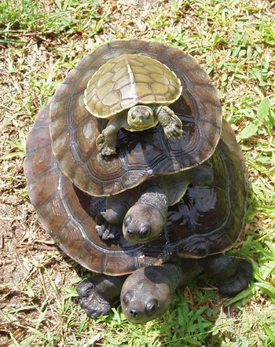
Questions?

Slide 58
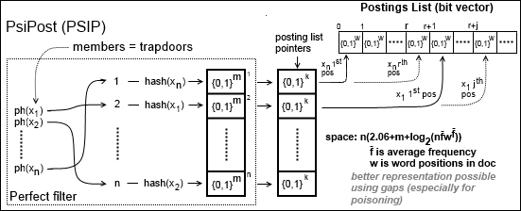

PSIP – more accurate diagram
$x_{i}$ freq = $x_{i+1}$ pointer address$−$ $x_{i}$ pointer address

Slide 59

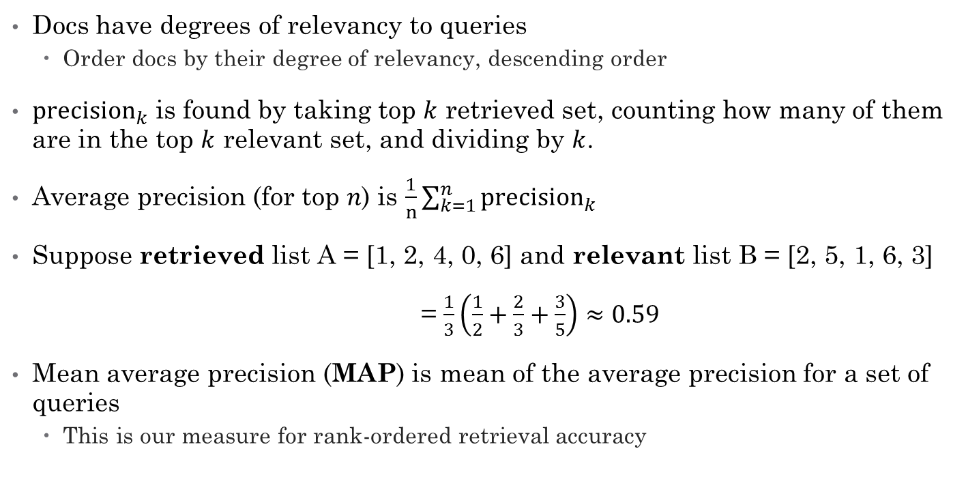
Measuring accuracy of rank-ordered searches
Docs have degrees of relevancy to queries
Order docs by their degree of relevancy, descending order
${\text{precision}}_{k}$ is found by taking top $k$ retrieved set, counting how many of them are in the top $k$ relevant set, and dividing by $k$.
Average precision (for top $n$) is $\frac{1}{n}\sum_{k=1}^{n}{{\text{precision}}_{k}}$
Suppose retrieved list A = [1, 2, 4, 0, 6] and relevant list B = [2, 5, 1, 6, 3]
= $\frac{1}{3}\left(\frac{1}{2}+\frac{2}{3}+\frac{3}{5}\right)≈0.59$
Mean average precision (MAP) is mean of the average precision for a set of queries
This is our measure for rank-ordered retrieval accuracy

